Slide 1
Environmental, Social, Governance (ESG)

Slide 2
Presenter
Kristian witt
Vice president, environmental SERVICES
kwitt@complianceplace.com
267-303-9319

Slide 3
Housekeeping
This presentation is being recorded and will be shared.
Everyone will be muted to prevent background noise.
Use the question button to log your question.

Slide 4
Today’s topics
What is ESG?
Are you required to participate?
What are typical areas of focus?
Developing a plan?
Who in your company should be involved?
Develop Key Performance Indicators

Slide 5
How did we get here?
The Corporate Responsibility started in the 1950s
1987 World Commission on Environment and Development Report
2006 Principles for Responsible Investment
2011 Jean Rogers founded the Sustainability Accounting Standards Board (SASB)
2015-2017 UN Sustainability Goals, Global Reporting Initiative (GRI), and The Compact for Responsive and Responsible Leadership
Current Status
Notes:
Howard Bowen’s book “Social Responsibilities of the Businessman. EPA has stated “Stormwater is the only growing source of water pollution in many watersheds across the country Environmental Issue that continues to grow”
It developed guiding principles for sustainable development as it is generally understood todayCWA Amendment of 1987 set forth a phased approach to regulating urban stormwater runoff through National Pollution Discharge Elimination System (NPDES) permits
Phase I MS4
Phase I Permitting
1999 – Phase II regulations
requires controls on stormwater discharges from a broader sector of municipalities, industries and construction sites

Slide 6
What Is ESG?
Framework to measure a company's impact on
environment
society
how transparent and accountable it is
Used as an investing tool
Mandatory Reporting Global Markets
Recalibrates Risk
Notes:
Only post link if going to it during webinar
https://www.epa.gov/npdes/authorization-status-epas-construction-and-industrial-stormwater-programs

Slide 7
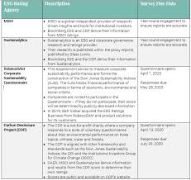
Do I need to be involved and Why
Most Likely at some level
Corporate Reporting
Customer Surveys
Rating Platforms
EcoVadis
CDP
And more
ESG reporting is a Global Effort
Important customers may demand it
Notes:
Construction sites
Manufacture/Industrial Facilities who’s Standard Industrial Classification (SIC) Code is one of the following:
24xx A: Timber Products
26xx B: Paper Products
28xx, 3952 C: Chemical Products
29xx D: Asphalt/Roofing 32xx
E: Glass, Clay, Cement 33xx
F: Primary Metals 10xx
G: Metal Mining 12xx
H: Coal Mines
13xx I: Oil and Gas
14xx J: Mineral Mining
HZ K: Hazardous Waste
LF L: Landfills
5015 M: Auto Salvage Yards
5093 N: Scrap Recycling
SE O: Steam Electric Facilities
40xx, 41xx, P: Land Transportation
42xx, 4311, 5171
44xx Q: Water Transportation
37xx R: Ship/Boat Building, Repair
45xx S: Air Transportation
TW T: Treatment Works (WWTPs)
20xx, 21xx U: Food Products
22xx, 23xx, 31xx V: Textile Mills
2434, 25xx W: Furniture and Fixtures
27xx X: Printing, Publishing
30xx, 39xx Y: Rubber, Misc. Plastics
3111 Z: Leather Tanning/ Finishing
34xx, 39xx AA: Fabricated Metal Products
35xx, 37xx AB: Transportation Equip.
357x, 38xx, 36xx AC: Electronic, photo goods
Sometimes both industrial and construction

Slide 8
Environmental
A Company’s impact on the planet
Use of Natural Resources
Bio Diversity
Carbon emissions as well as Criteria and Hazardous Air Pollutants
Solid Waste
Water use and wastewater
Energy

Slide 9
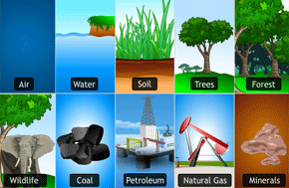
Environmental – Natural Resources
Renewable Energy Sources
Reduce and recycling programs
Alternative Raw Materials
Control Technologies
Hazardous Materials
Product End of Life
Consumption Optimization

Slide 10
Environmental – Biodiversity
Variety and Variability on Life
Impact of operations on species
Loss poses a risk to the environment
Habitat Destruction
Invasive Species
Not straightforward
Outside resource and support will be needed

Slide 11
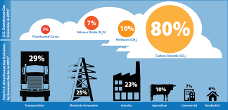
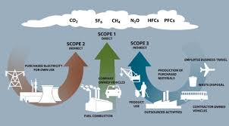
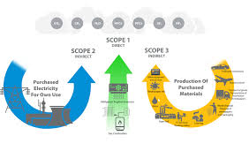
What is your Carbon Foot Print and more
Greenhouse Gas Emissions
Scope 1 – Direct – Combustion, Refrigerant Leaks, Process emissions
Scope 2 – Indirect – Energy Consumption
Scope 3 – Supply Chain Upstream and Downstream
15 Categories
Other air emissions and reduction efforts

Slide 12
Waste Management
Reduce
Reuse
Recycling
Recovery
Employee Training

Slide 13
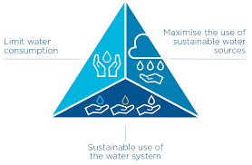
Water
Water Consumption
Recycling
Discharge Volume
Contamination
Stormwater No Exposure
Treatment

Slide 14
Energy
Consumption
Renewable Energy
Efficiency
Renewable Credits
Related to Carbon foot print

Slide 15
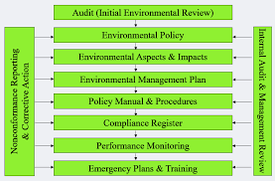
Other environmental
ISO14001
EMS
Responsible Care
ECO Certifications

Slide 16
social Topics
Employee Relations
Worker Conditions
Training
Supply Chain labor practices
Diversity Sustainability
Legal Requirements
Notes:
Multi-Sector General Permit (MSGP)– Most Popular
Two types of General Permits – Construction and Industrial
Construction General Permit is separate from any local requirements.
Construction General Permit require for disturbances greater that 1 acre
May be less than 1 acre if the plan is ultimately part of a larger project
Preset conditions
Individual Permit
Just what it means - Site-specific Permit
If you cannot comply with the General Permit
Pertains to a single facility
Typical if you have a process water discharge not allowed by the General Permit
Will list specific monitoring and conditions for compliance
Will generally include requirements from the general permit

Slide 17
Worker Conditions
Safe Work Practices
Working Conditions
Labor Relations
DEI
Wages

Slide 18
Worker Training
Waste reduction
Air emissions
Energy conservation
Water conservation
Hazardous materials handling
Health and Safety Risks
Subcontractor/Temp Employees

Slide 19
Governance
How an organization is governed?
Risks and opportunities in decision making
What are the responsibilities of Participants in an organization?
Board of Directors
Managers
Shareholders
Stakeholders
Organization Transparency
It is an indication of Risk in the ability to capitalize on business opportunities.

Slide 20
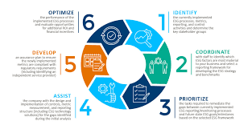
What now – Develop a Plan
Establish your ESG Team
Cross functional
Identify Key ESG issues
What factors are most relevant
Carbon Footprint
Waste
Labor
Engage Stakeholders
Internal and Stakeholders
Establish most impactful ESG issues
Set ESG Goals and KPIs
Action Plan
Notes:
Individual Required – If the site cannot comply with all GP regulations
Lack of BMP’s
Off-site discharges above limitations
Discharges into a designated/restricted stream (High Quality or above a federal Tier [Tier 3])
A point source or sector specific discharge that is prohibited by regulation
Impact the surrounding environment (i.e. endangered species or critical habitat)
Non-Stormwater discharges intentionally introduced by the facility.
Possible site-specific numeric effluent limitations were established.
Know your operation and know your permit requirements.

Slide 21
What now – Develop a Plan cont.
Implement and Integrate
Company Policies
Operations must incorporate ESG into business decisions, processes, SOPs
Company Culture
Engage and train employees
Track Progress
Monitor against KPIs
Adjust
Report
Continuous Improvement
Living Effort
Bench mark against industry standards

Slide 22
Who is involved
ESG Lead
EHS
HR
Purchasing
Finance
IT
External Advisors/ Consultants

Slide 23
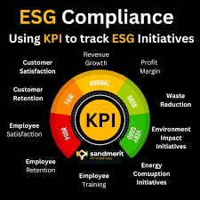
Key Performance Indicators
Establish Smart Goals and KPIs
GHG emissions – next year, all energy purchased will be renewable.
Water – All water will be recycled in 5 years
Waste – Reduce waste by 50% Zero hazardous waste.
Bio Diversity – Protect habitat and reduce deforestation
Health and Safety incident Reduction
Increase Training hours

Slide 24
Questions?
Thank You.

Slide 25
Get in Touch: kwitt@complianceplace.com www.Complianceplace.com

